Slide 1
Bioinformatics
Molecular Techniques

Slide 2
What is the smallest step you can do to be called a ‘Bioinformatician’ (or any other field)?

Slide 3
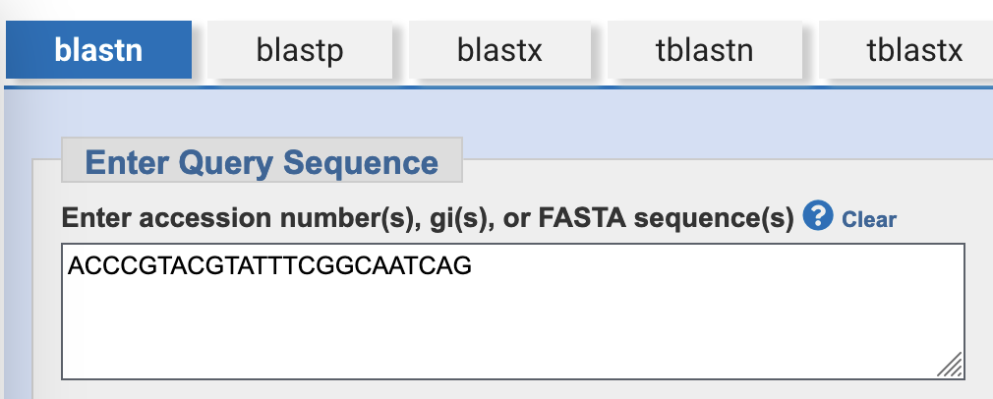
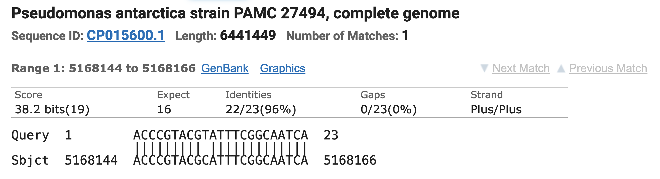
Matching a sequence of letters to another
https://blast.ncbi.nlm.nih.gov/Blast.cgi

Slide 4
Matching sequences across species

Slide 5
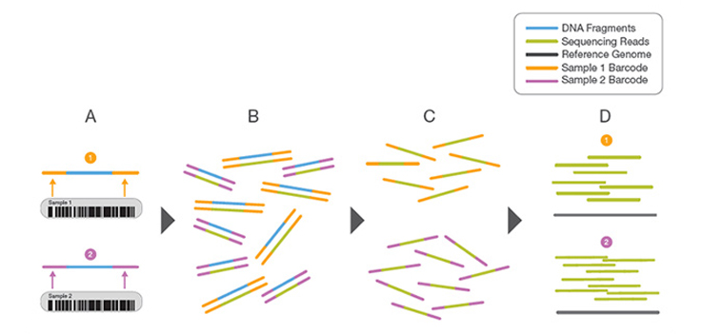
Multiplexing
https://www.illumina.com/techniques/sequencing/ngs-library-prep/multiplexing.html

Slide 6
Raw sequencing data
@SRR001666.1 071112_SLXA-EAS1_s_7:5:1:817:345 length=36
GGGTGATGGCCGCTGCCGATGGCGTCNAATCCCACC
+
IIIIIIIIIIIIIIIIIIIIIIIIIIIIII9IG9IC
@SRR001666.2 071112_SLXA-EAS1_s_7:5:1:801:338 length=36
GTTCAGGGATACGACGTTTGTATTTTAAGAATCTGA
+
IIIIIIIIIIIIIIIIIIIIIIIIIIIIIIII6IBI

Slide 7
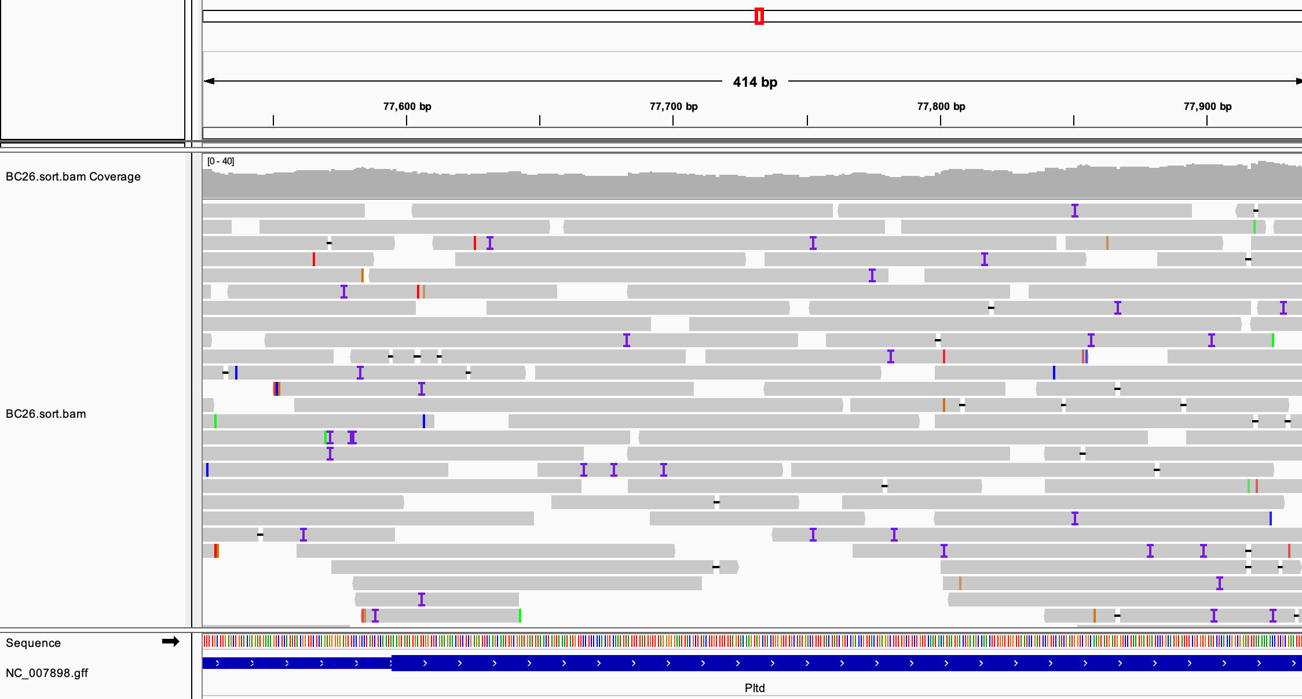
Matching reads to a reference
https://blast.ncbi.nlm.nih.gov/Blast.cgi

Slide 8
Genetics
DNA

Slide 9
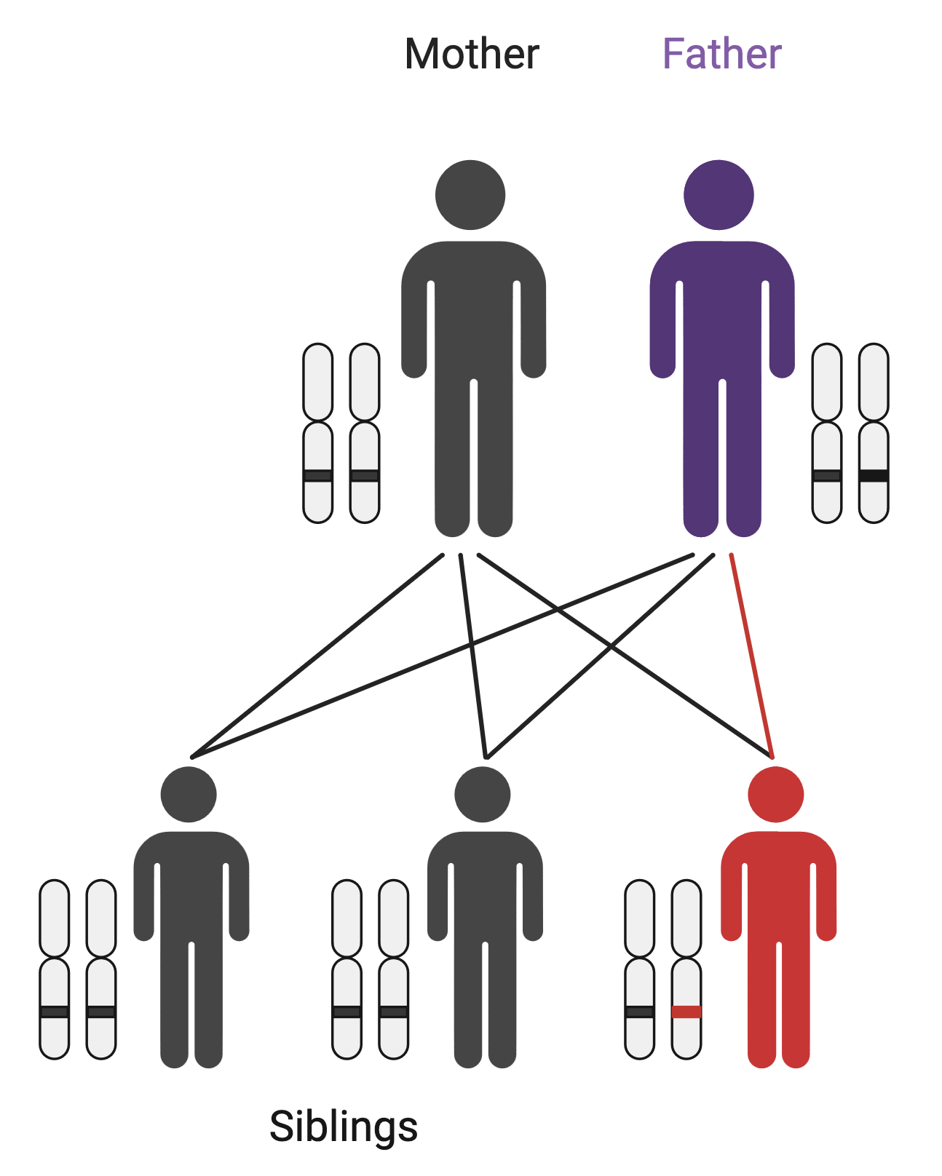

Rare diseases – de novo mutations
Mother: ATTCG
Father: ATTCG
Child: ATTGG
Sibling: ATTCG

Slide 10
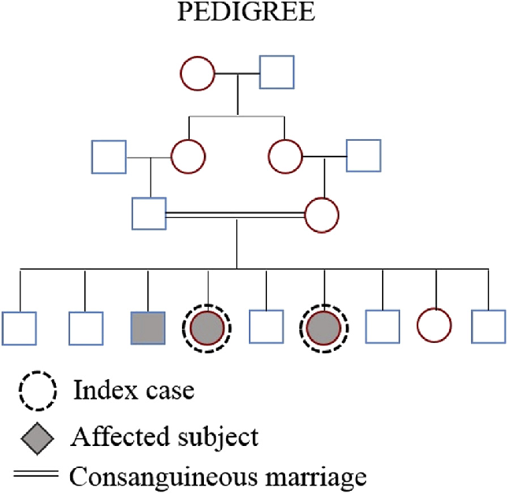
Rare diseases – consanguinity
Soares, D. et al. (2016). Pyle disease (metaphyseal dysplasia) presenting in two adult sisters. Radiology Case Reports. 11. 10.1016/j.radcr.2016.10.003.

Slide 11
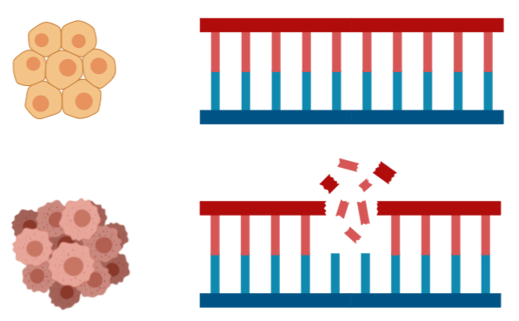

Cancer genetics
Sequence tumour sample and normal sample from the same patient.
Normal: GCTTAGCT
Cancer: GC_ _ _GCT

Slide 12
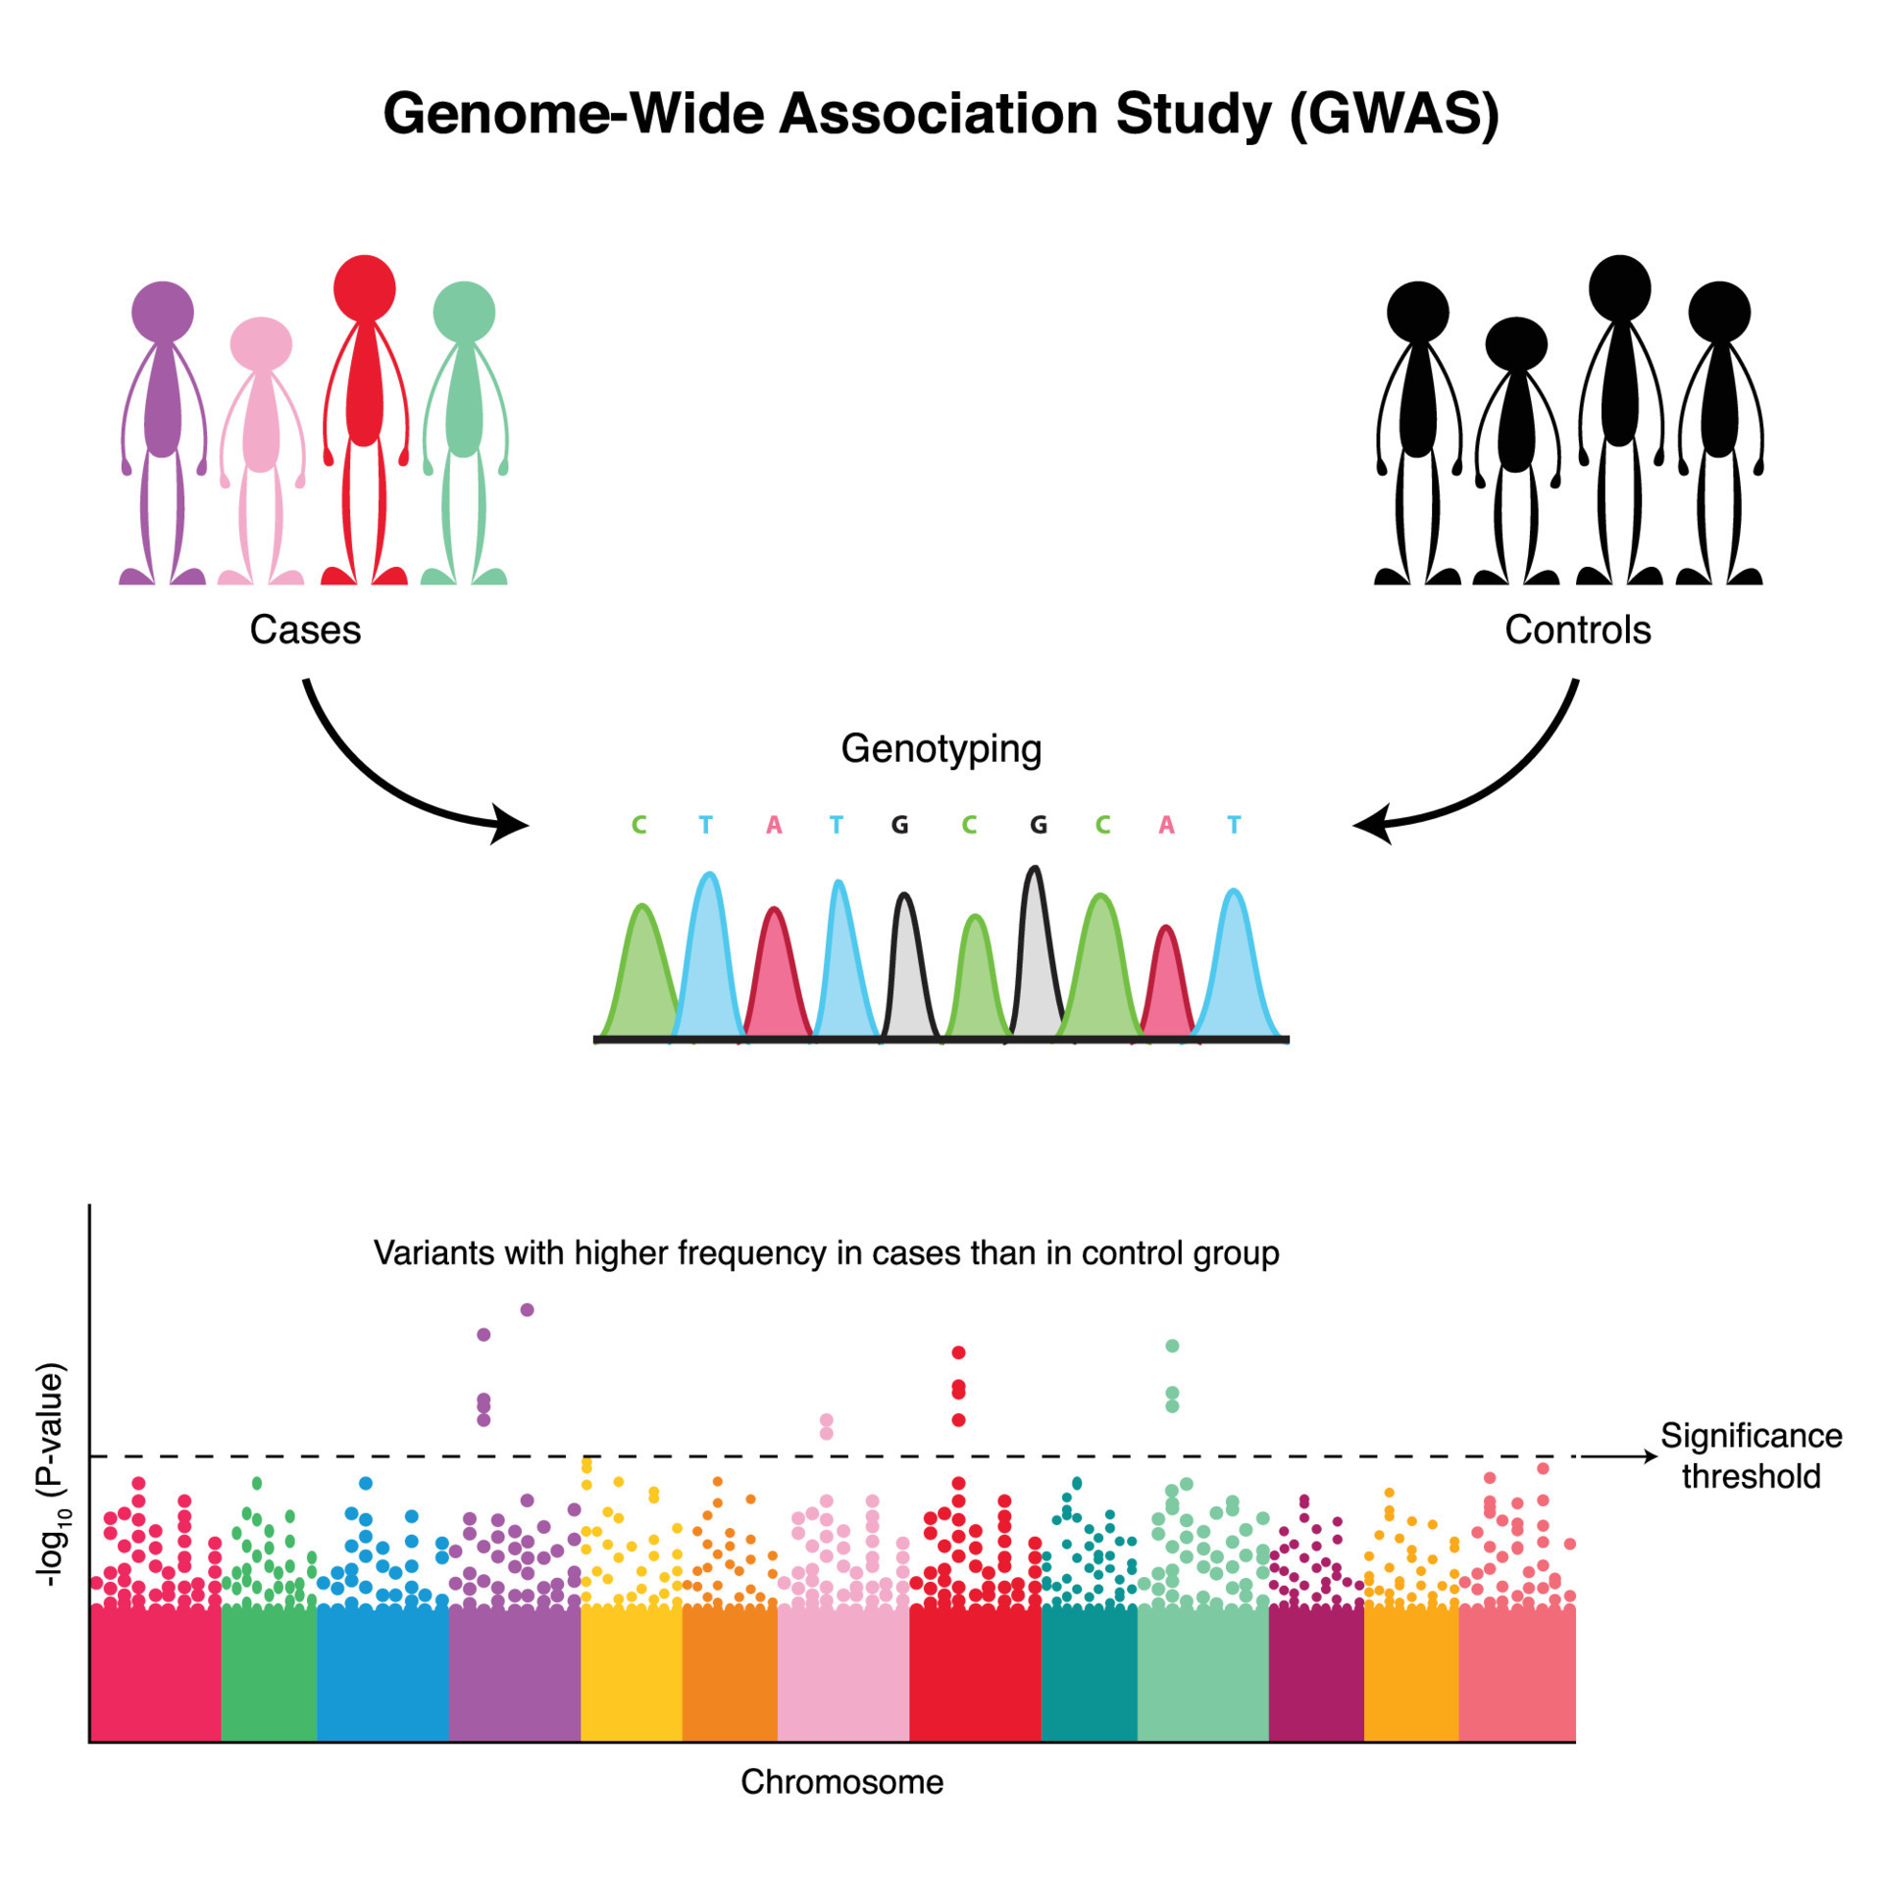
Complex traits / Common diseases
https://www.vecteezy.com/vector-art/7508599-genome-wide-association-study-diagram

Slide 13
DNA-sequencing methods compared
Feature | Genotyping | Sanger Sequencing | Next-Generation Sequencing (NGS) | Long-Read Sequencing
Throughput | Low (limited number of variants) | Low (one sequence at a time) | High (whole genome, exome, or targeted regions) | High (whole genome, longer reads)
Read Length | N/A (focuses on known variants) | ~500-1,000 bp | Short reads (~100-300 bp) | Long reads (~10,000-100,000+ bp)
Quantification | Relative allele frequency | Absolute sequence determination | Quantitative (read counts) | Quantitative (read counts)
Novel Variant Detection | No (only known variants) | Limited (low-throughput for discovering variants) | Yes (novel variants, large-scale discoveries) | Yes (structural variants, repetitive regions)
Sensitivity | Moderate (detects common variants) | High for specific regions | High | High, especially for structural variations
Cost | Low (especially for large cohorts) | Medium for small-scale sequencing | High | High
Turnaround Time | Fast (high-throughput variant detection) | Slow (one sequence at a time) | Moderate to fast (depends on scale) | Moderate to slow (long read processing)
Typical Read Depth | N/A (specific alleles only) | ~1x-3x per sequence | Varies (e.g., ~30x for whole genome sequencing) | Moderate (~10-30x, varies with technology)
Error Rate | Very low | Very low | Moderate (higher than Sanger, but manageable) | Higher error rate than NGS
Applications | Common variant detection (e.g., SNP arrays) | Small gene or locus sequencing | Whole-genome/exome sequencing, gene panels | Structural variants, long contiguous sequences
Typical Use Cases | GWAS, population studies | Small-scale targeted gene sequencing, validation | Large-scale sequencing projects (genomics, cancer) | Complex genome regions, structural variation
Notes:
Examples:
Genotyping:
Illumina Infinium or Affymetrix GeneChip SNP arrays: These are widely used in genome-wide association studies (GWAS) and population genetics studies for identifying common variants across large cohorts.
Sanger Sequencing:
Applied Biosystems (ABI) Sanger Sequencers: ABI 3730xl is a commonly used instrument for small-scale, targeted sequencing, especially for validating variants or sequencing specific gene regions.
Next-Generation Sequencing (NGS):
Illumina: HiSeq, NovaSeq, MiSeq platforms are the most commonly used NGS technologies for whole-genome, whole-exome, and targeted sequencing. Illumina dominates the NGS market with short-read sequencing technologies.
Long-Read Sequencing:
Pacific Biosciences (PacBio): Sequel II platform offers long-read sequencing with relatively high accuracy (HiFi reads) and is used for sequencing repetitive or complex regions of the genome.
Oxford Nanopore Technologies (ONT): MinION, PromethION platforms are used for ultra-long reads, which can span tens of kilobases, useful for sequencing large structural variants or assembling whole genomes.

Slide 14
DNA-sequencing workflow
Raw Data Quality Control: FastQC ↡ Adapter Trimming and Quality Filtering: Trimmomatic or Cutadapt ↡ Read Alignment: BWA ↡ Mark Duplicates: Picard or GATK ↡ Base Quality Score Recalibration (BQSR): GATK BaseRecalibrator
Variant Calling: GATK HaplotypeCaller ↡ Variant Filtration: GATK VariantFiltration ↡ Post-Processing QC: VCFtools or bcftools ↡ Annotation of Variants: ANNOVAR or snpEff
Notes:
Raw Data Quality Control Tool: FastQC Purpose: Assess quality of raw FASTQ files (e.g., sequencing errors, GC content, adapter contamination). ↡
Adapter Trimming and Quality Filtering Tool: Trimmomatic or Cutadapt Purpose: Remove adapter sequences and low-quality reads to clean the raw data. Branch: Once cleaned, return to quality control for re-evaluation with FastQC. ↡
Read Alignment Tool: BWA Purpose: Align the cleaned reads to the reference genome (e.g., GRCh38 for humans). ↡
SAM to BAM Conversion and Sorting Tool: SAMtools Purpose: Convert SAM file to BAM format and sort the BAM file for further analysis. ↡
Mark Duplicates Tool: Picard or GATK Purpose: Identify and mark PCR duplicates to avoid bias in variant calling. Branch: QC check for duplicates and read distribution, review if necessary. ↡
Base Quality Score Recalibration (BQSR) Tool: GATK BaseRecalibrator Purpose: Recalibrate base quality scores to correct systematic sequencing errors. ↡
Variant Calling Tool: GATK HaplotypeCaller Purpose: Call SNPs and indels from the aligned and recalibrated BAM file. ↡
Variant Filtration Tool: GATK VariantFiltration Purpose: Apply filters to refine the called variants based on quality criteria (e.g., QD, FS, MQ). ↡
Post-Processing QC Tool: VCFtools or bcftools Purpose: Evaluate the quality of filtered variants, such as SNP density, transition/transversion ratio. ↡
Annotation of Variants Tool: ANNOVAR or snpEff Purpose: Annotate the variants for functional impact (e.g., coding/non-coding, synonymous, nonsynonymous).

Slide 15
Functional Genomics
DNA -> RNA

Slide 16
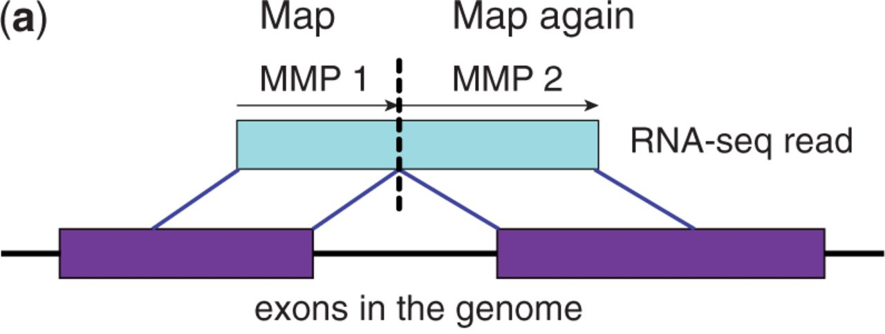

Mapping RNA sequences to the genome
Bioinformatics, Volume 29, Issue 1, January 2013, Pages 15–21, https://doi.org/10.1093/bioinformatics/bts635
The content of this slide may be subject to copyright: please see the slide notes for details.

Slide 17
Bulk RNA-sequencing workflow
Raw Data Quality Control: FastQC ↡ Adapter Trimming and Quality Filtering: Trimmomatic or Cutadapt ↡ Read Alignment: STAR or HISAT2 ↡ SAM to BAM Conversion and Sorting: SAMtools ↡ Transcript Assembly and Quantification: StringTie or featureCounts ↡ Differential Expression Analysis: DESeq2 or edgeR
Notes:
Raw Data Quality Control Tool: FastQC Purpose: Assess quality of raw FASTQ files (e.g., sequencing errors, GC content, adapter contamination). ↡
Adapter Trimming and Quality Filtering Tool: Trimmomatic or Cutadapt Purpose: Remove adapter sequences and filter low-quality reads to clean the raw data. Branch: After trimming, return to FastQC to reassess data quality. ↡
Read Alignment Tool: STAR or HISAT2 Purpose: Align the cleaned reads to a reference genome (e.g., GRCh38 for humans). ↡
SAM to BAM Conversion and Sorting Tool: SAMtools Purpose: Convert SAM file to BAM format and sort the BAM file for downstream analysis. ↡
Transcript Assembly and Quantification Tool: StringTie or featureCounts Purpose: Assemble transcripts and quantify gene or transcript-level expression from aligned reads. ↡
Differential Expression Analysis Tool: DESeq2 or edgeR Purpose: Identify differentially expressed genes between conditions by comparing gene expression counts.

Slide 18
Bulk RNA-sequencing workflow
Raw Data Quality Control: FastQC ↡ Adapter Trimming and Quality Filtering: Trimmomatic or Cutadapt ↡ Read Alignment: STAR or HISAT2 ↡ SAM to BAM Conversion and Sorting: SAMtools ↡ Transcript Assembly and Quantification: StringTie or featureCounts ↡ Differential Expression Analysis: DESeq2 or edgeR
Read Alignment & Quantification: Salmon or Kallisto
Notes:
Quantification of Transcript Abundance Tool: Salmon or Kallisto Purpose: Perform rapid, alignment-free quantification of transcript abundance from raw RNA-seq reads by directly mapping to a reference transcriptome.

Slide 19
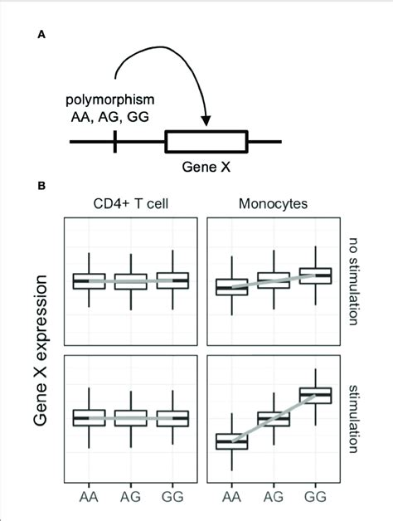
Genotyping and Gene expression: expression Quantitive Trait Loci
Nagafuchi, Y. et al. (2022). Lessons From Transcriptome Analysis of Autoimmune Diseases. Frontiers in Immunology. 13. 857269. 10.3389/fimmu.2022.857269.

Slide 20
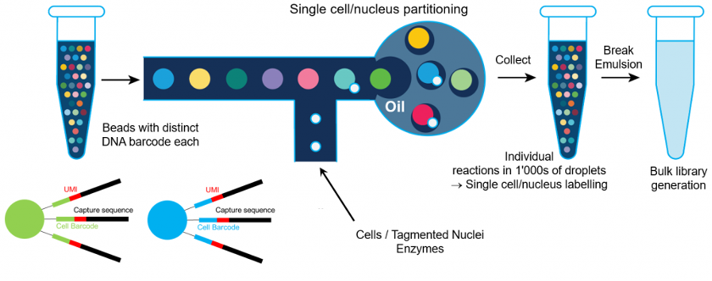
Single cell RNA-seq
Drop-seq from 10X Genomics

Slide 21
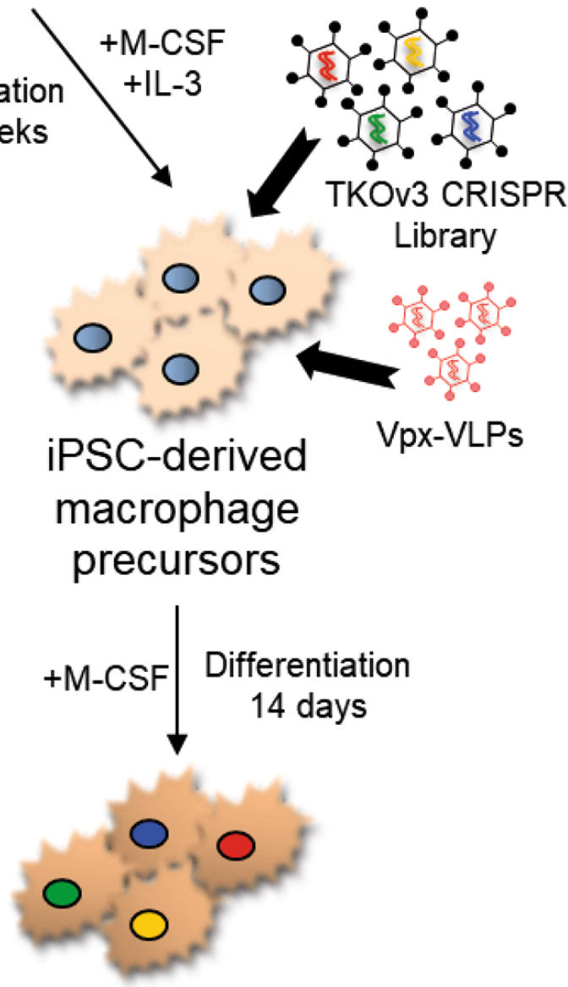
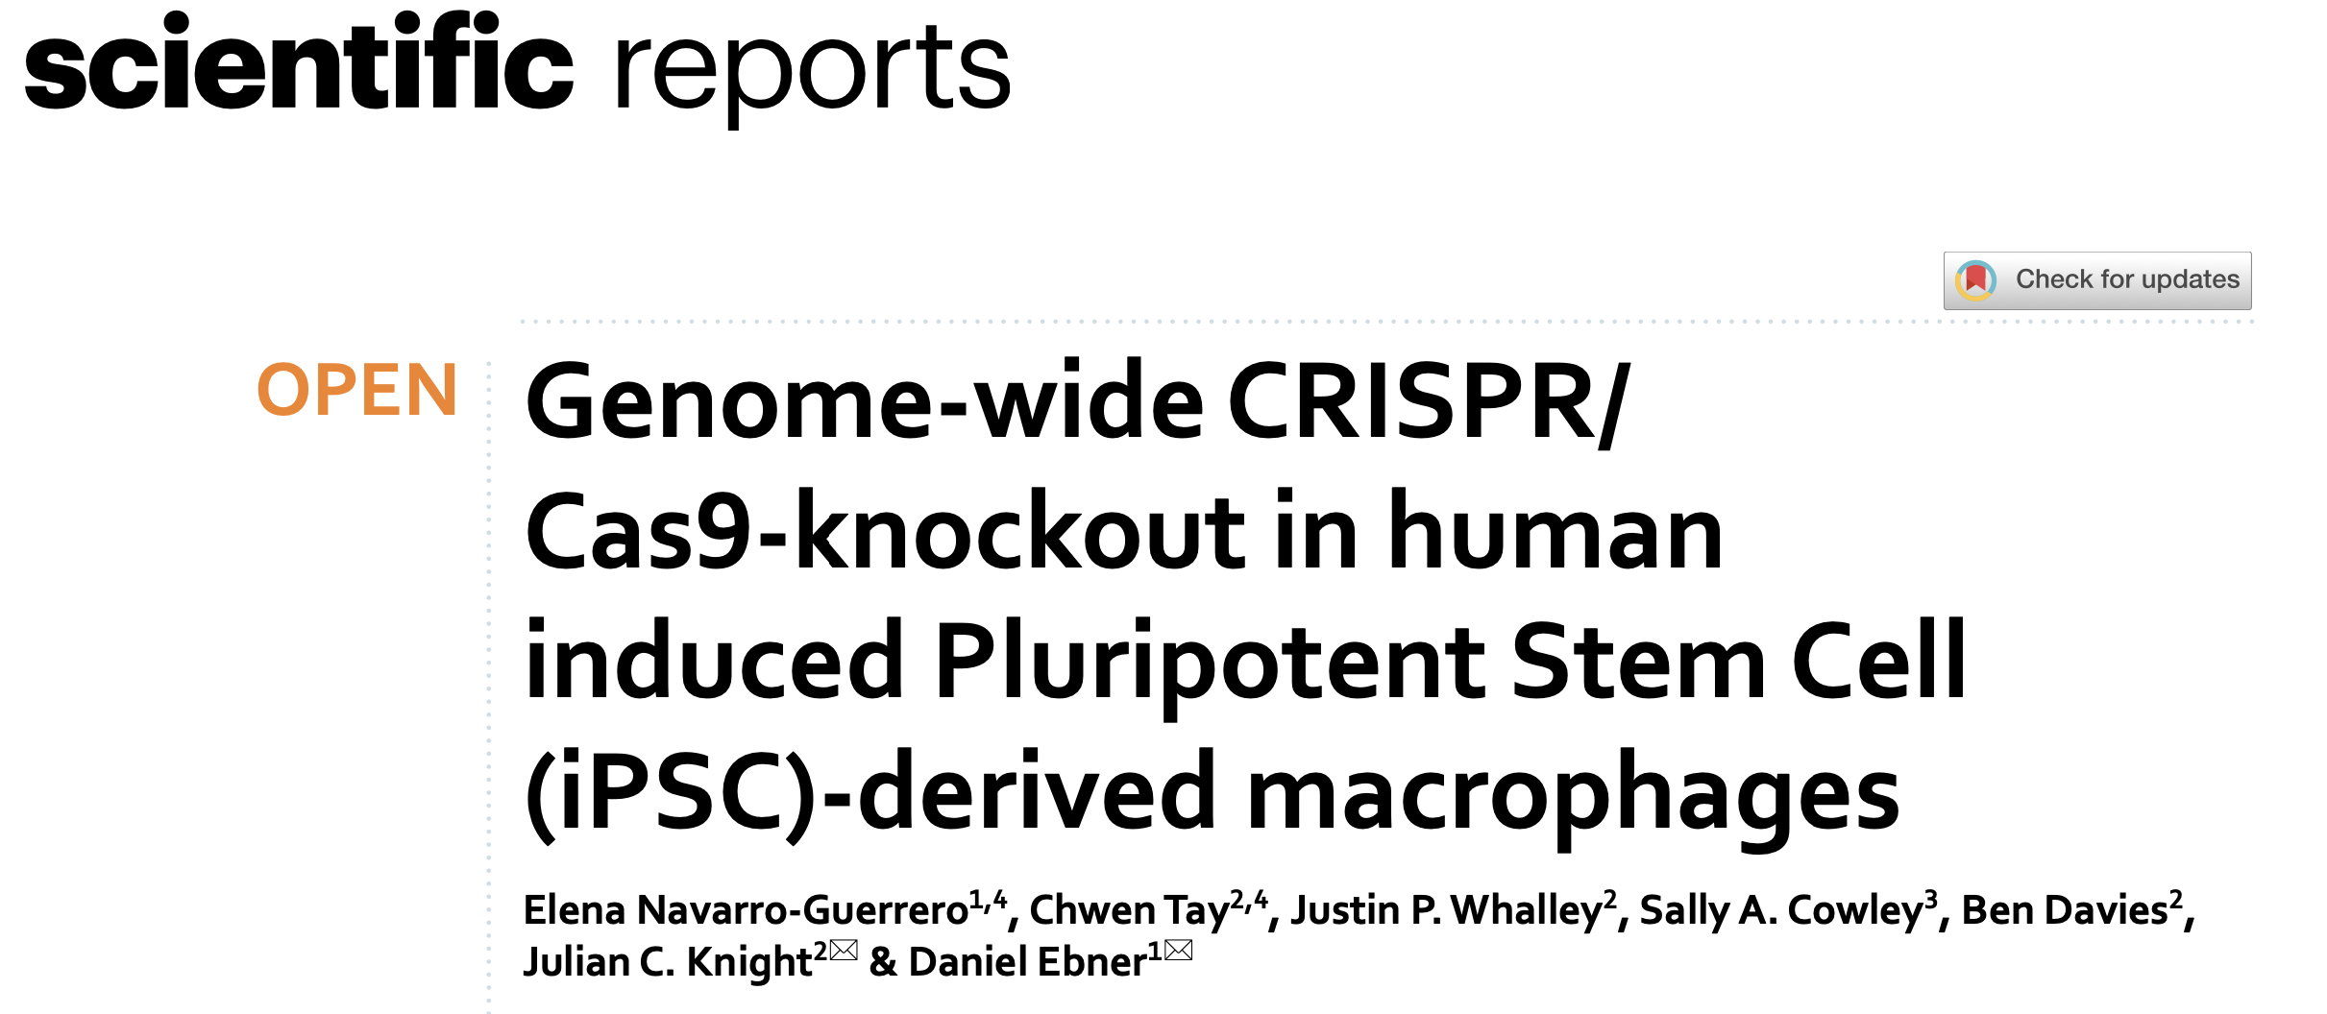
Which genes are important?

Slide 22
Environmental effects
Epigenetics
DNA -> RNA

Slide 23
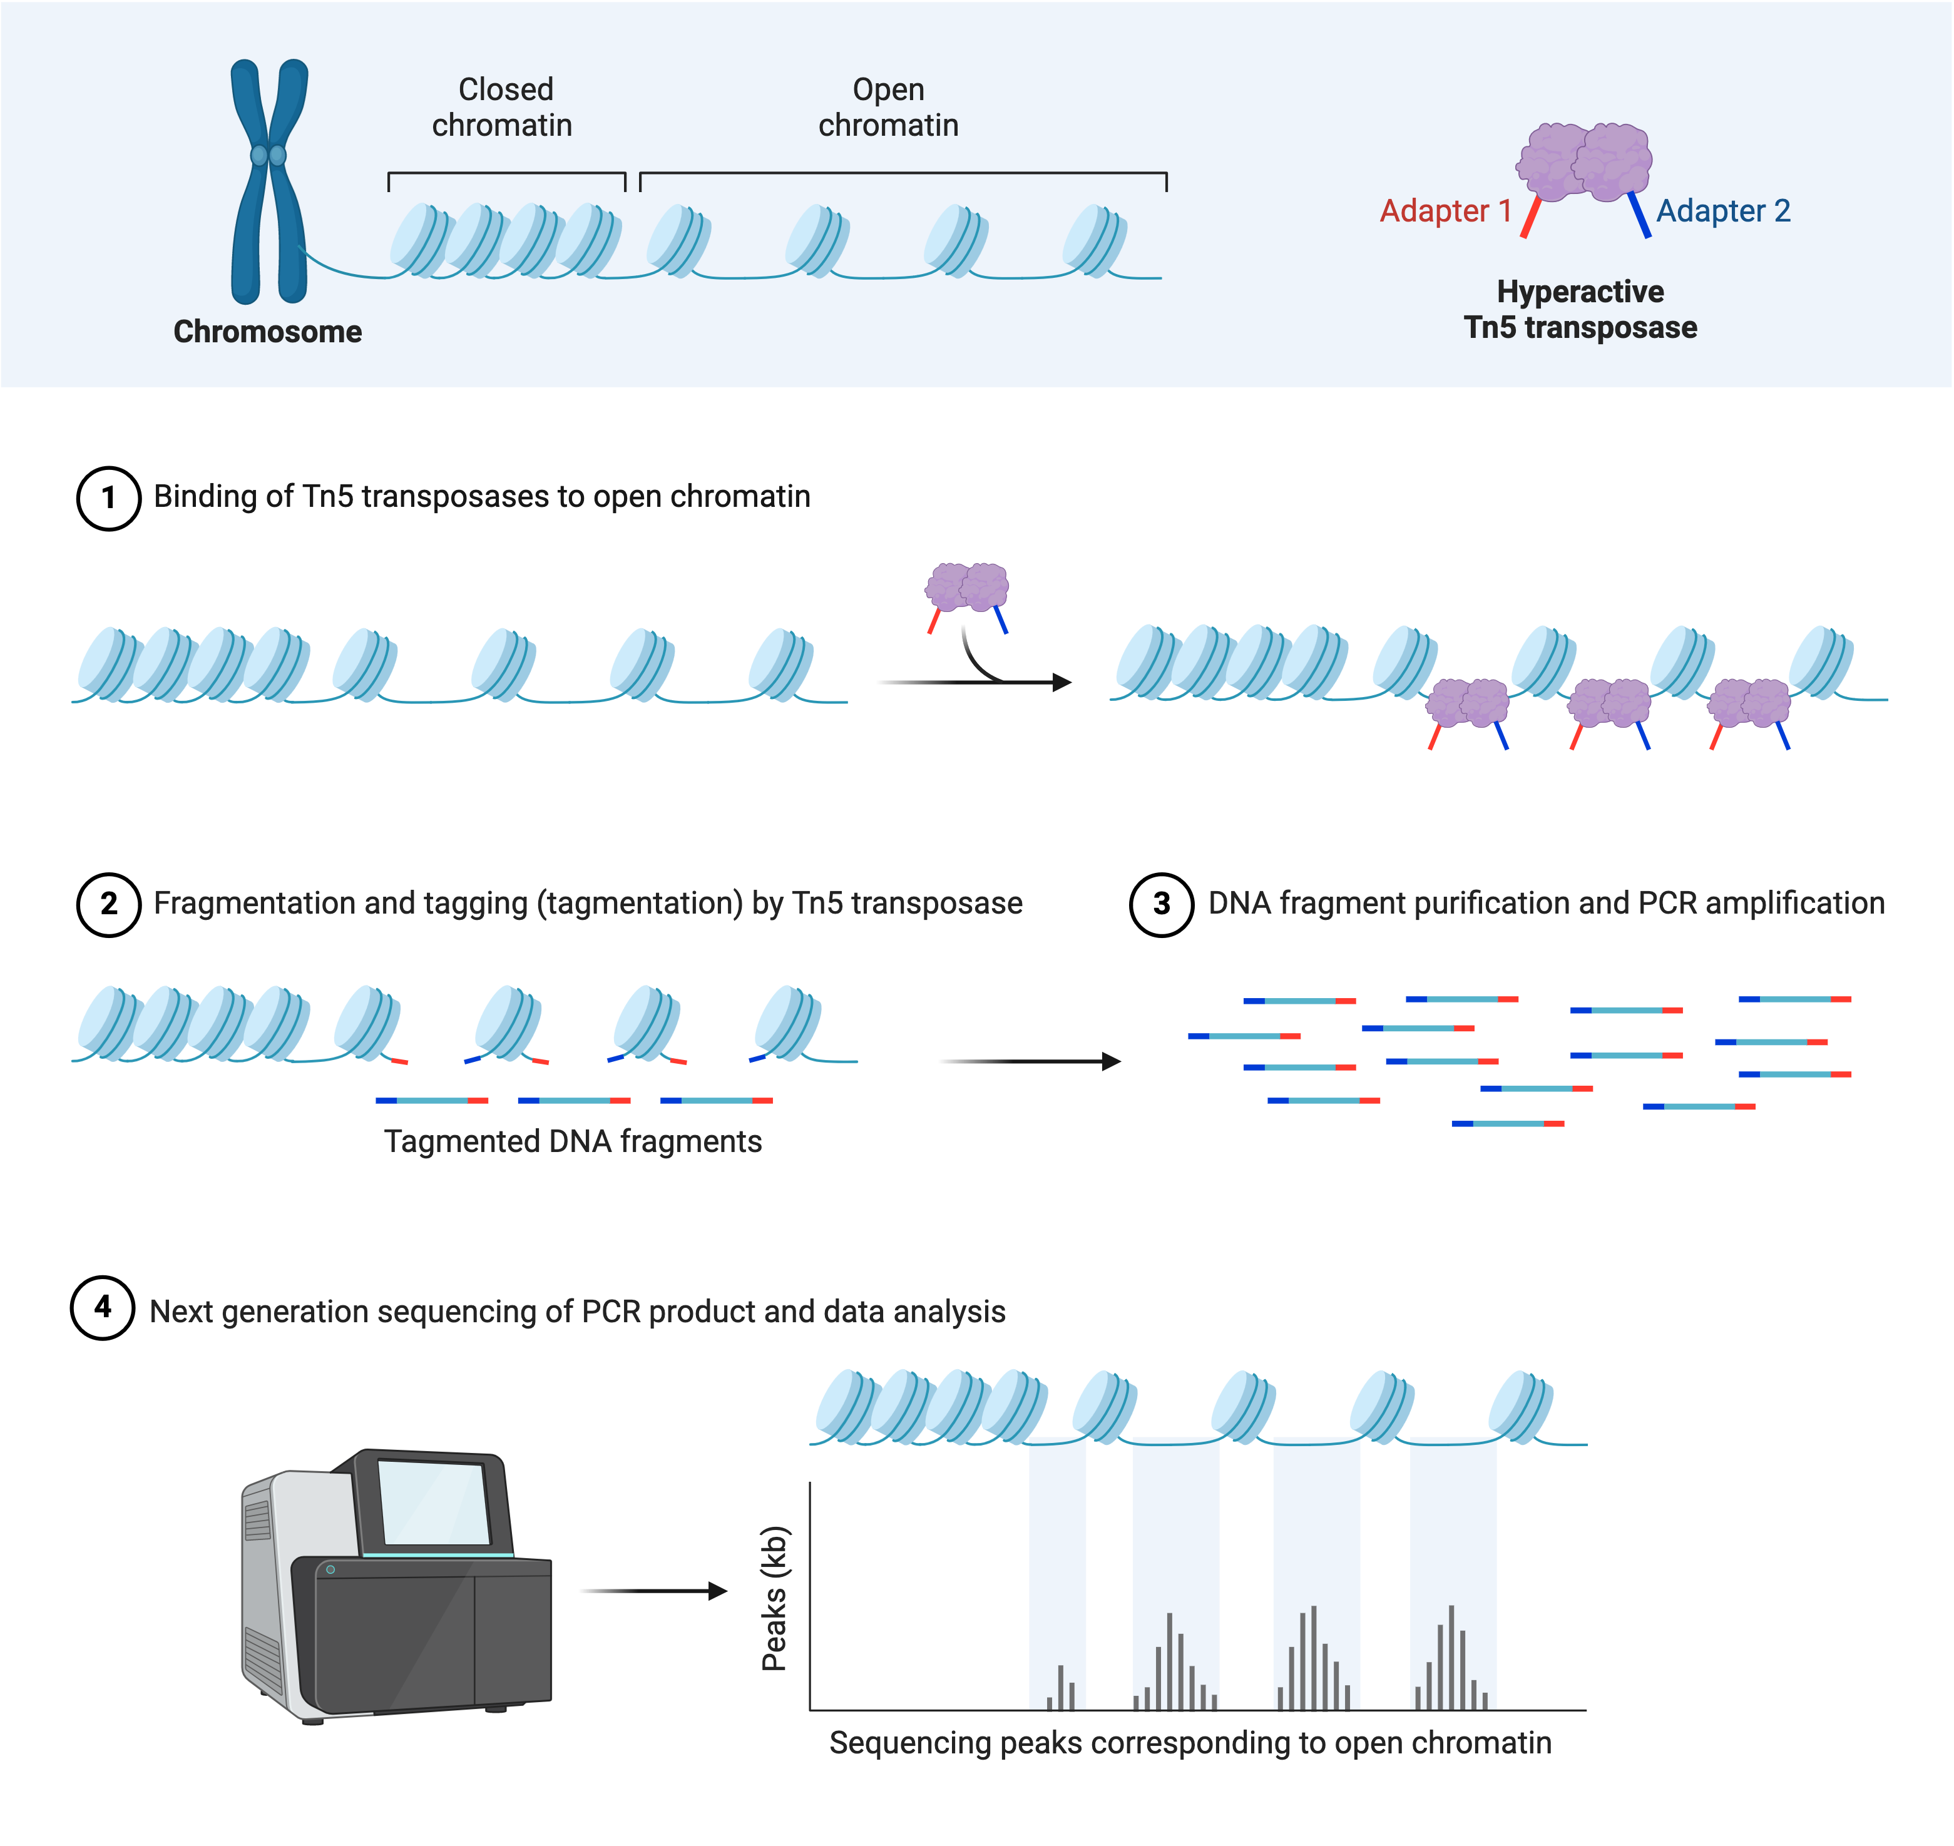
ATAC-seq: Assay for Transposase-Accessible Chromatin
Created with BioRender.com

Slide 24
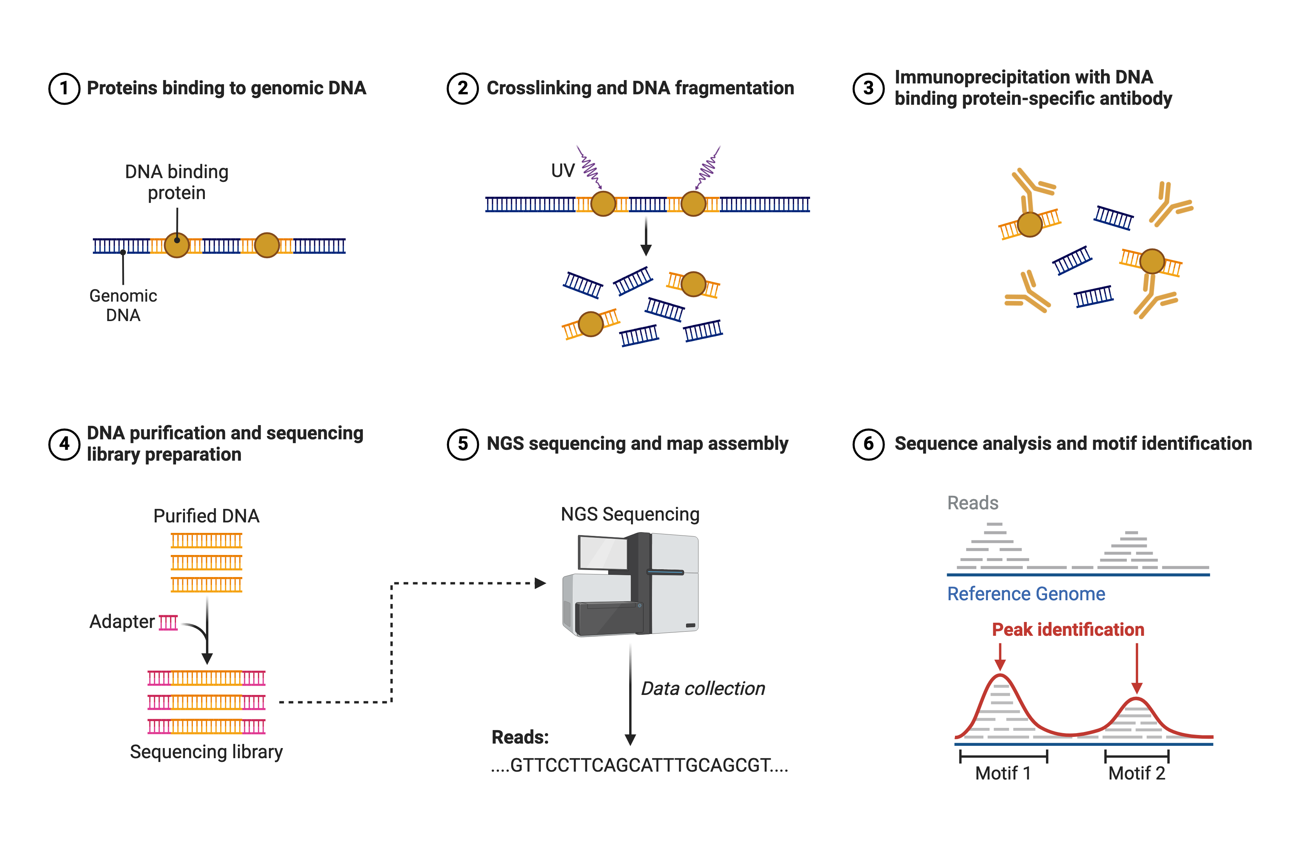
ChIP-seq
Created with BioRender.com

Slide 25
Analysis of the data
Epigenetics
DNA -> RNA -> Proteins

Slide 26
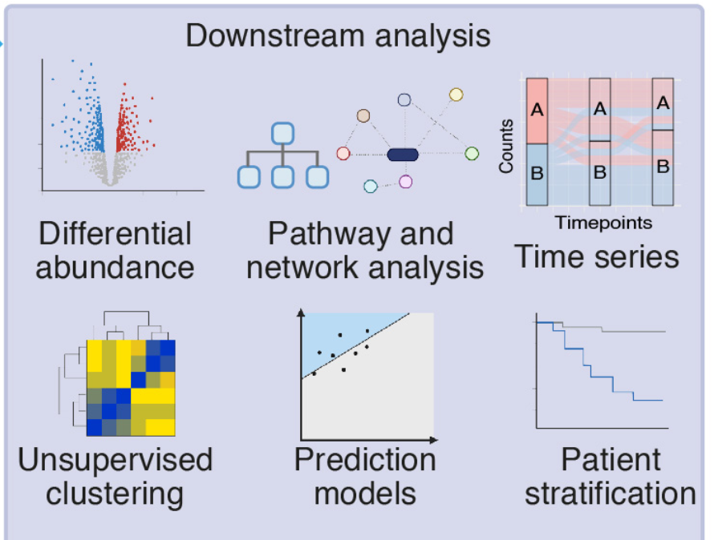
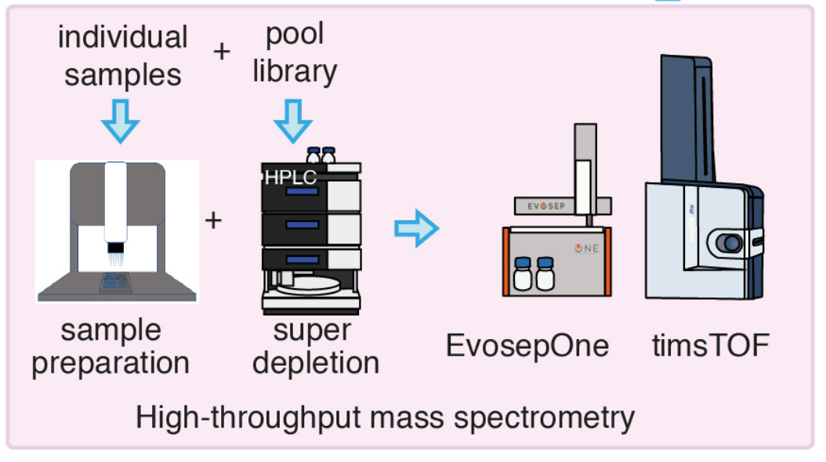
Analysis of Proteins

Slide 27
Other data
Epigenetics
DNA -> RNA -> Proteins
Metabalomics
Cellular data Lipidomics
Imaging Data
Phenotypes

Slide 28
‘omic data versus phenotypic data
Power law
Normal distribution

Slide 29
Normalization of data

Slide 30
Normalization of data

Slide 31
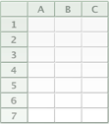
Sanity check of the data
400 donors
15,000 genes
Naive
IFNγ
Fairfax et al. Innate immune activity conditions the effect of regulatory variants upon monocyte
gene expression. Science, 2014.
Treatment
LPS 2h
LPS 24h

Slide 32
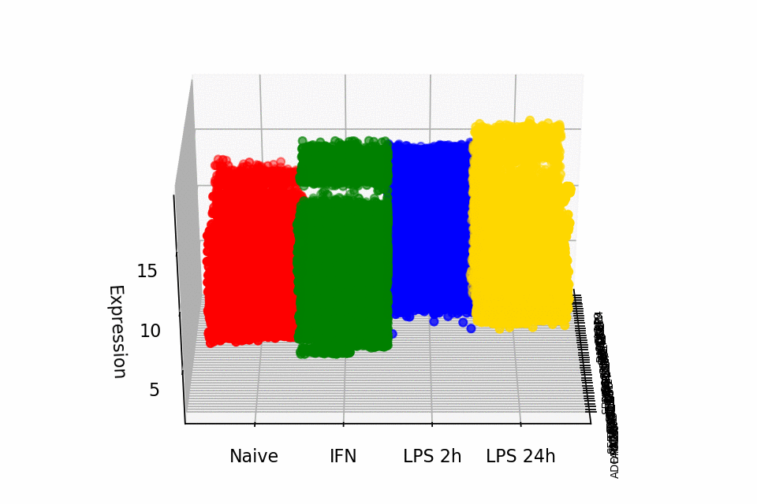
Sanity check of the data

Slide 33
Dimension reduction – Gene Expression

Slide 34
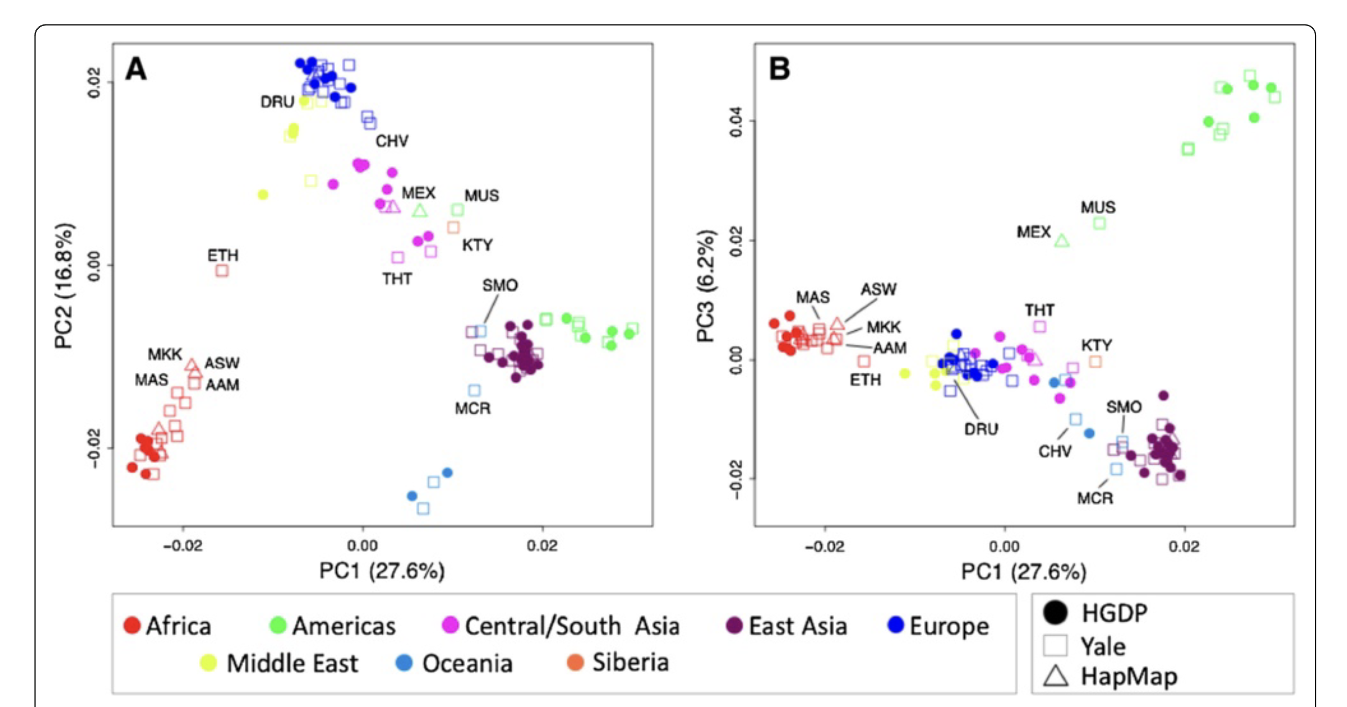
Dimension reduction – Genetics
Nievergelt et al. Investigative Genetics 2013, 4:13

Slide 35
Dimension reduction

Slide 36
Normalization of data

Slide 37
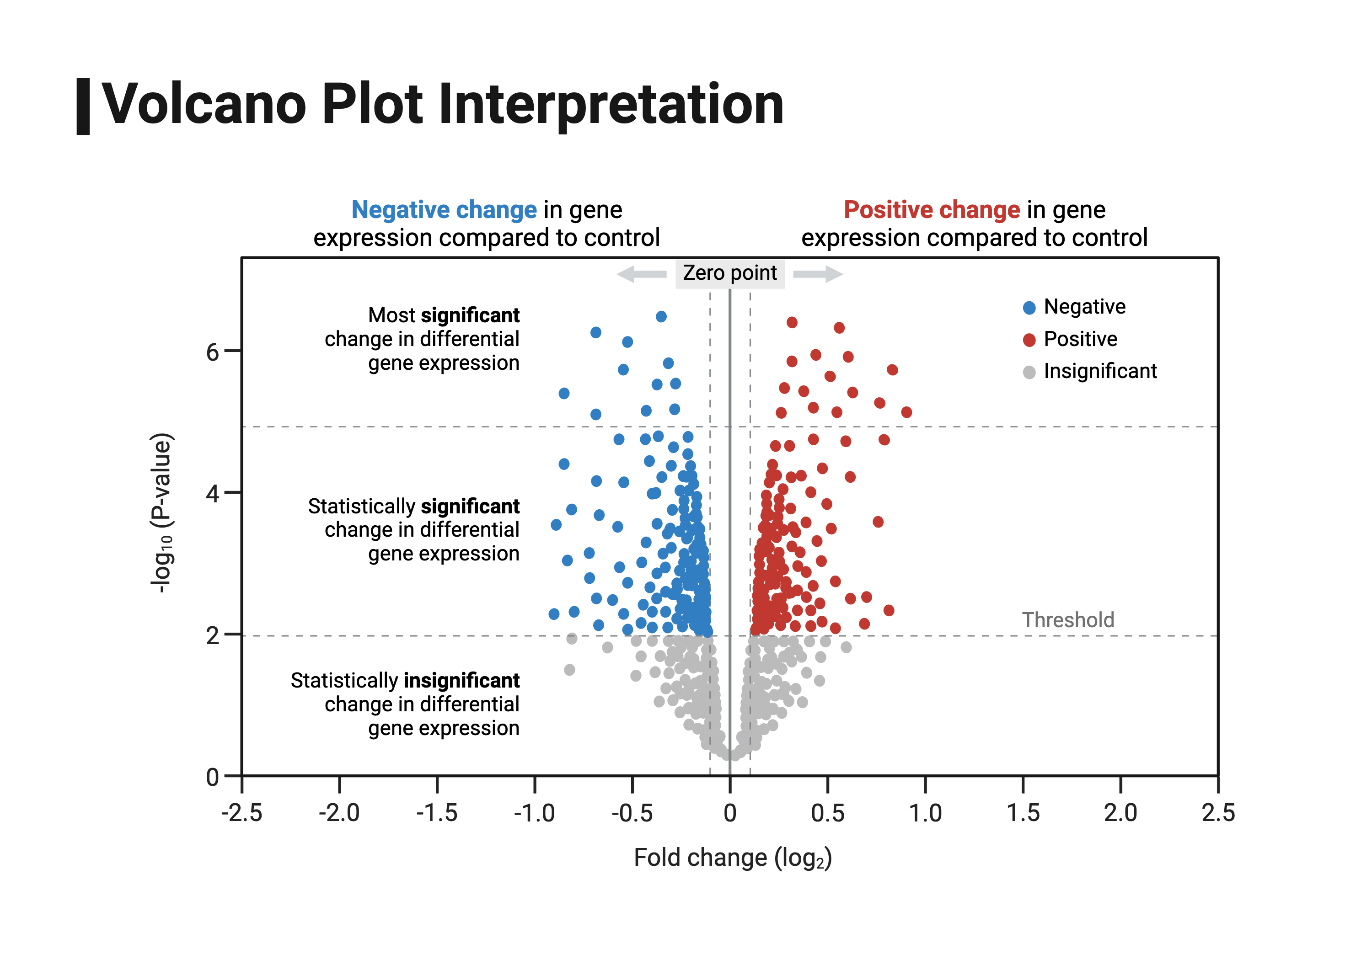
Which genes/proteins are important
Biorender

Slide 38
Which pathways are important?

Slide 39
Questions?

Slide 40
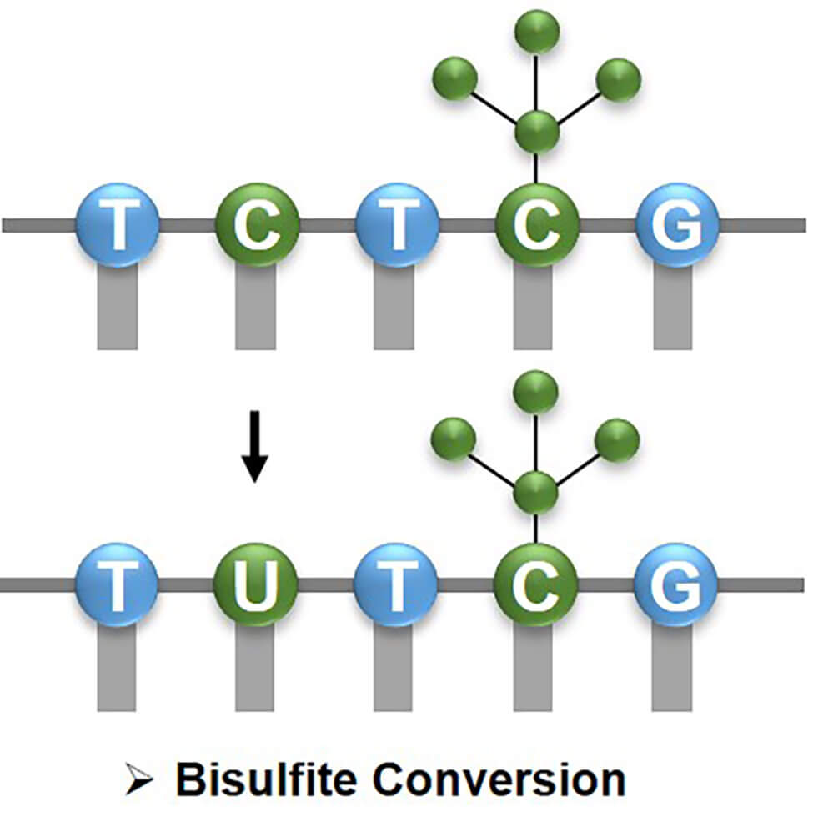
Methylation
https://www.creativebiomart.net/epigenetics/wp-content/themes/epigenetics

